Slide 1
Petivity
Low-Fi Prototype

Slide 2



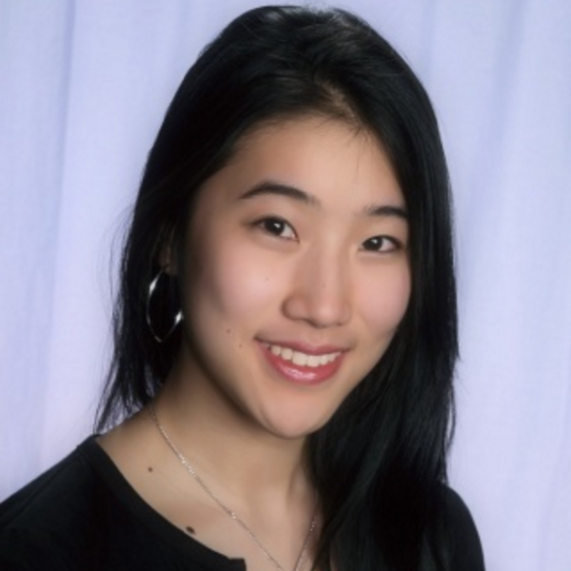
MEET THE TEAM
Ivan Salinas
Sidra Ijaz
Crystal Zheng
Jonathan Mao
Notes:
People often have a difficult time completing tasks because of distractions, poor time management, and/or unhealthy work-life balance.

Slide 3
1.
Mission Statement

Slide 4
Petivity
“Productivity’s Best Friend”
Problem: People often have a difficult time completing tasks because of distractions, poor time management, and/or unhealthy work-life balance.
Solution: We aim to increase productivity by effectively eliminating distractions and keeping people on track in a fun and engaging way.
Notes:
Productivtiy because most people can relate to it

Slide 5
Selected Interface
Notes:
From Deborah we also came up with two of our strongest HMW

Slide 6
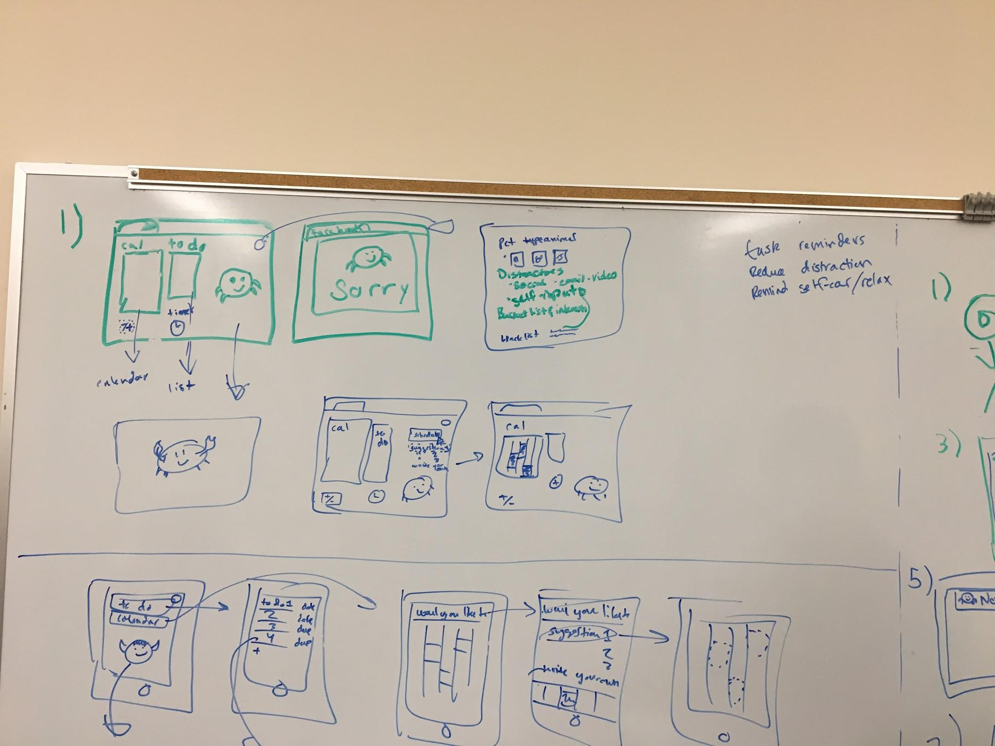
Interface 1
Notes:
Productivtiy because most people can relate to it

Slide 7
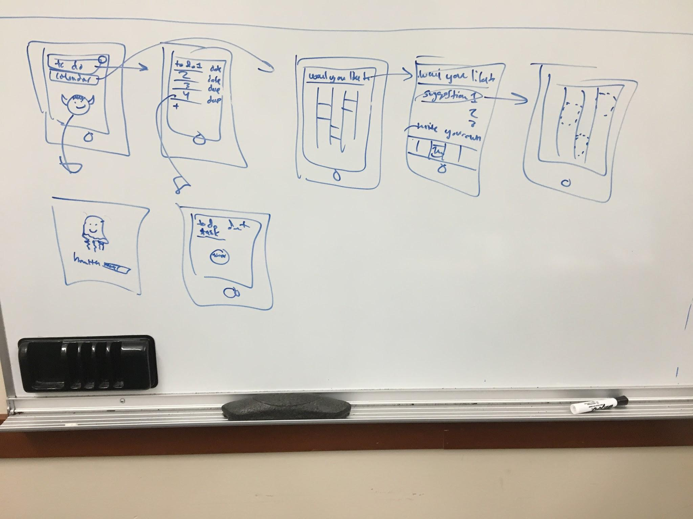
Interface 2
Notes:
Productivtiy because most people can relate to it

Slide 8
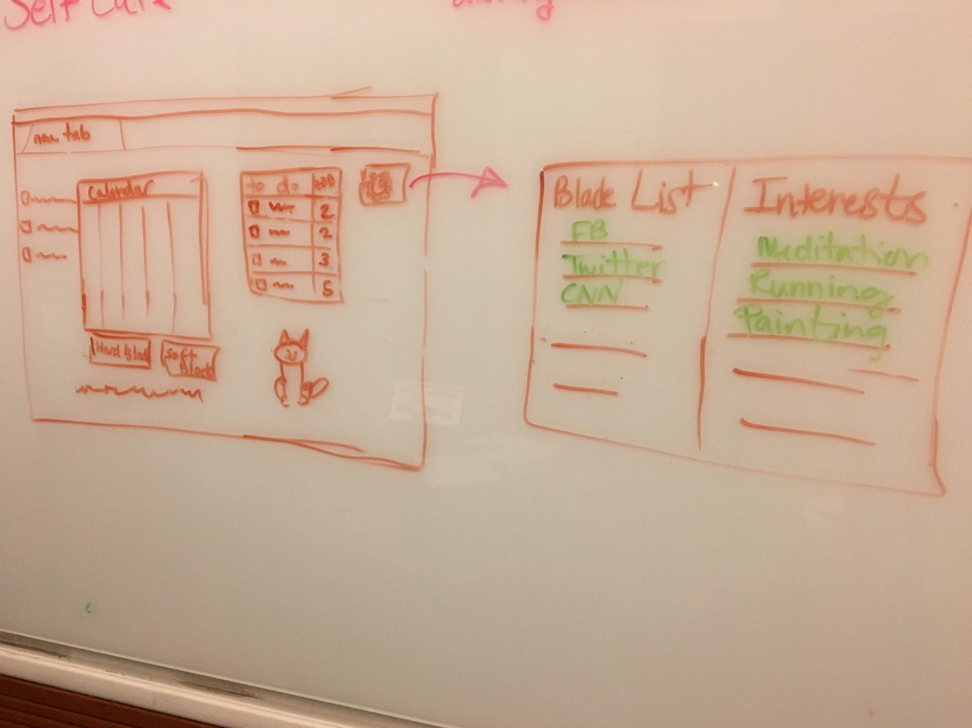
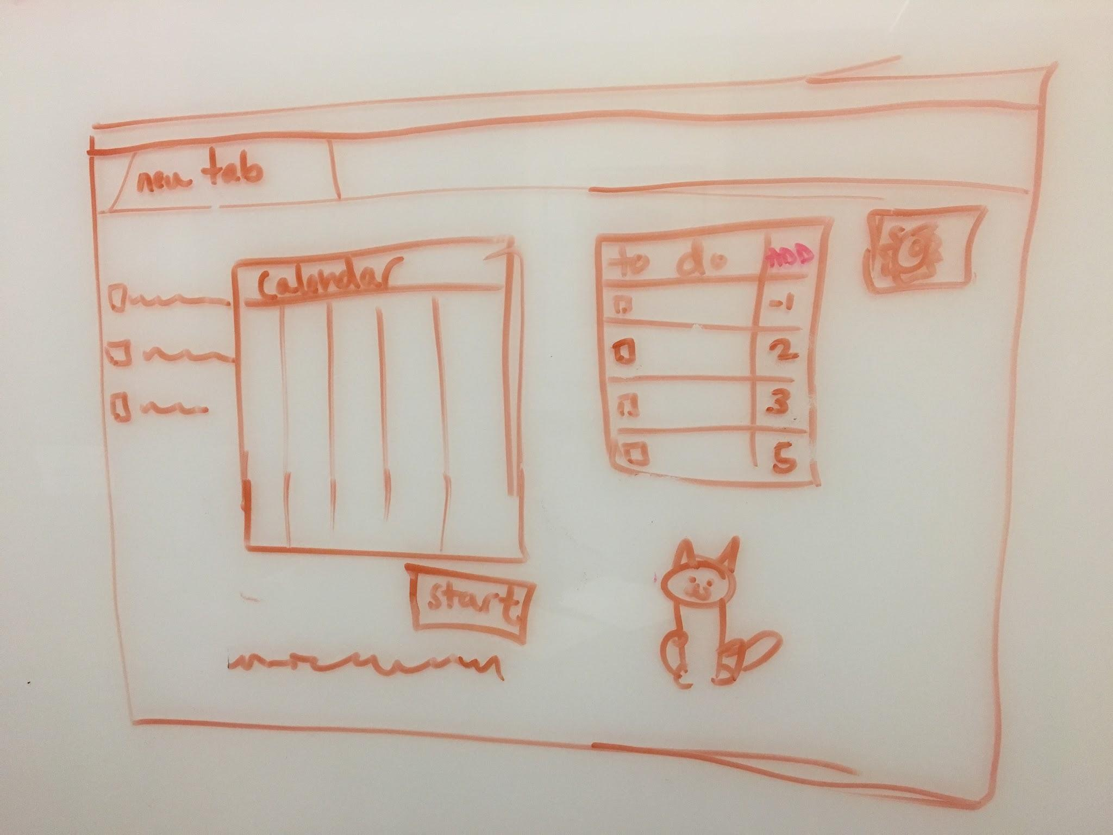
Selected Interface: Web Application
People more likely to work on computers than on their phones
Interviewees noted they would like a more effective way to stay focused while on their computers
Can completely block distracting websites
Opens as new tab home screen so everything is at a glance
Notes:
Productivtiy because most people can relate to it

Slide 9
3.
Low-Fi Prototype

Slide 10
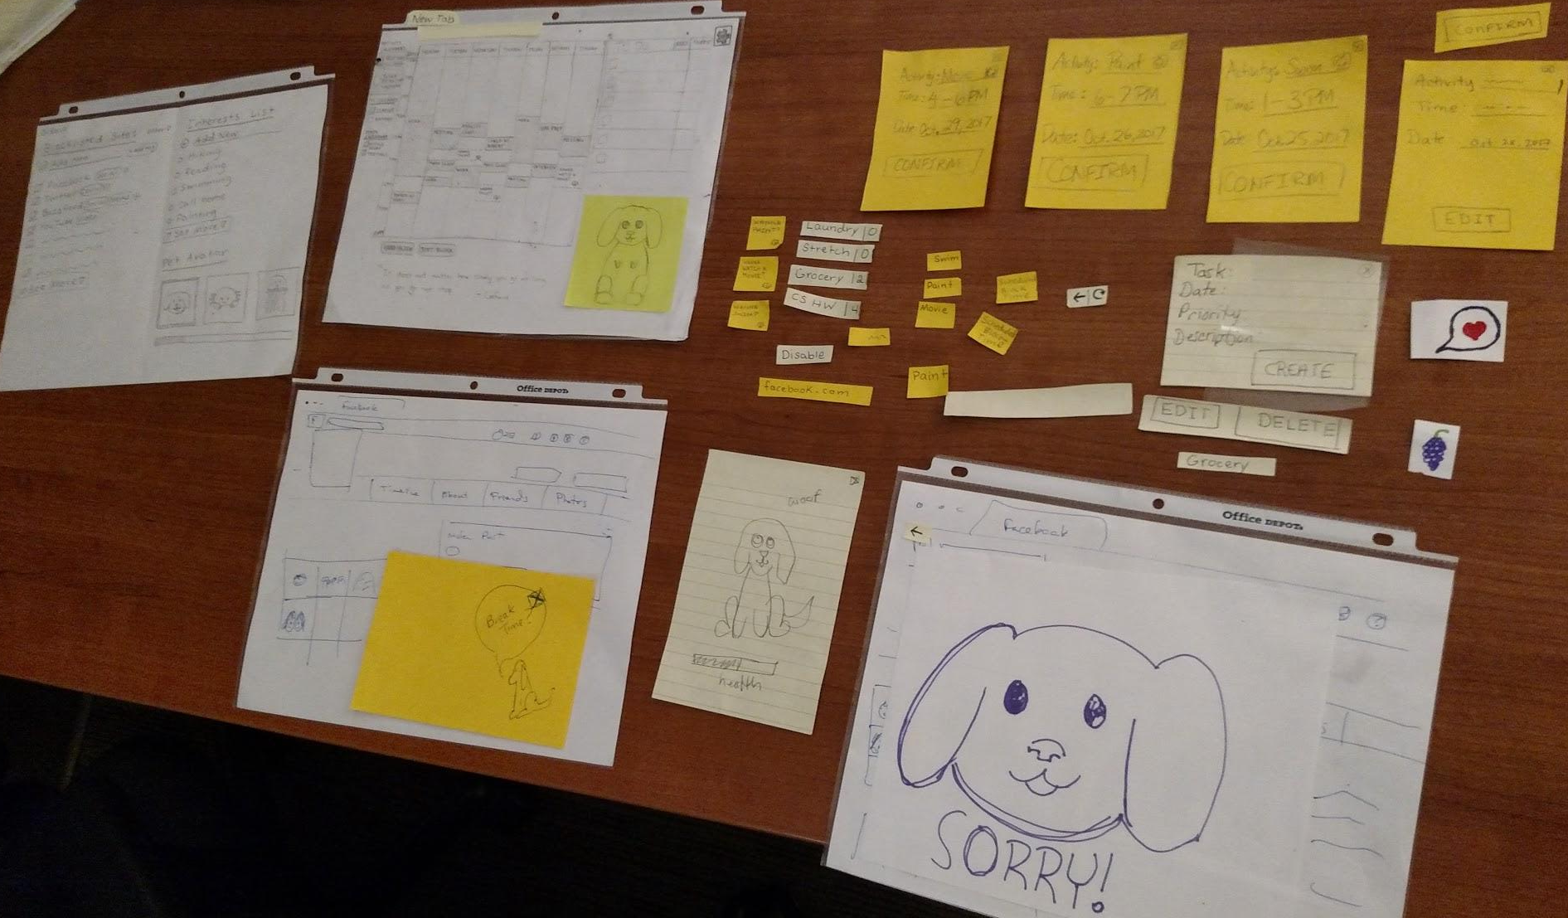
Lo-Fi Prototype
Notes:
Productivtiy because most people can relate to it

Slide 11
4.
Task Flow

Slide 12
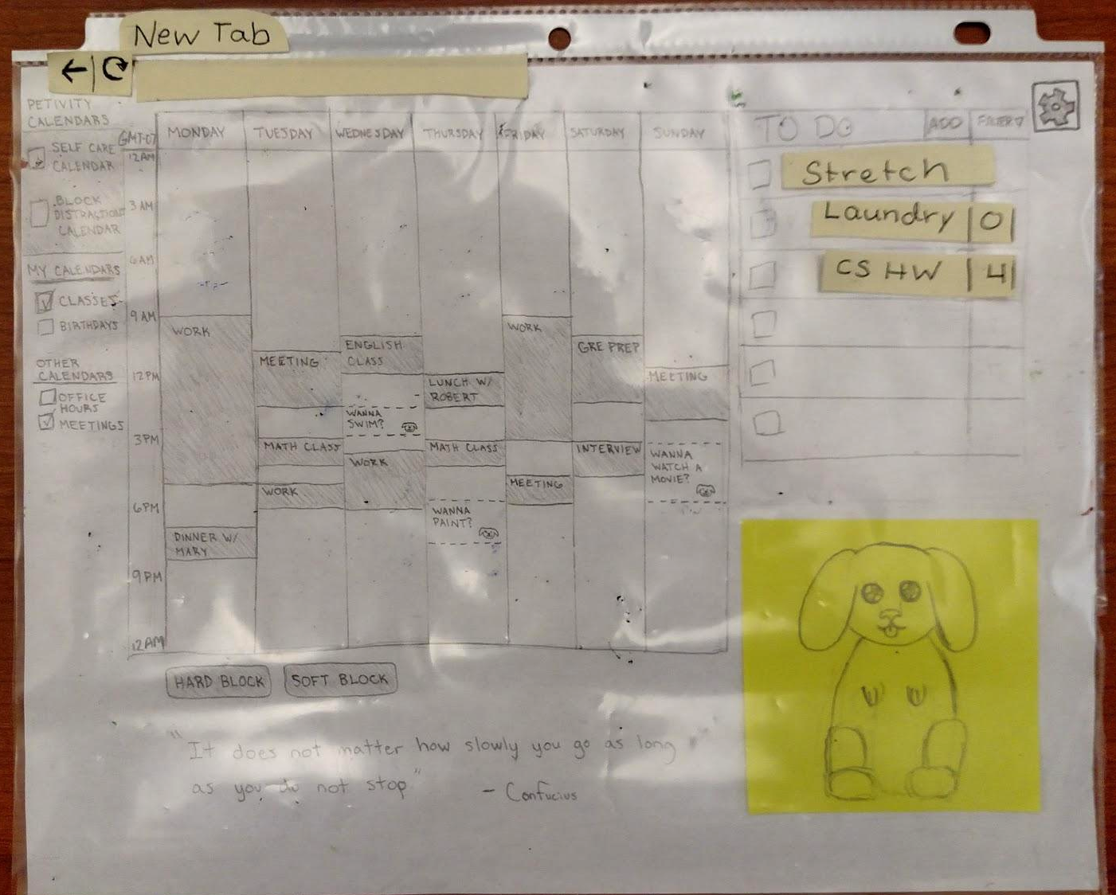
Task 1
Notes:
Productivtiy because most people can relate to it

Slide 13
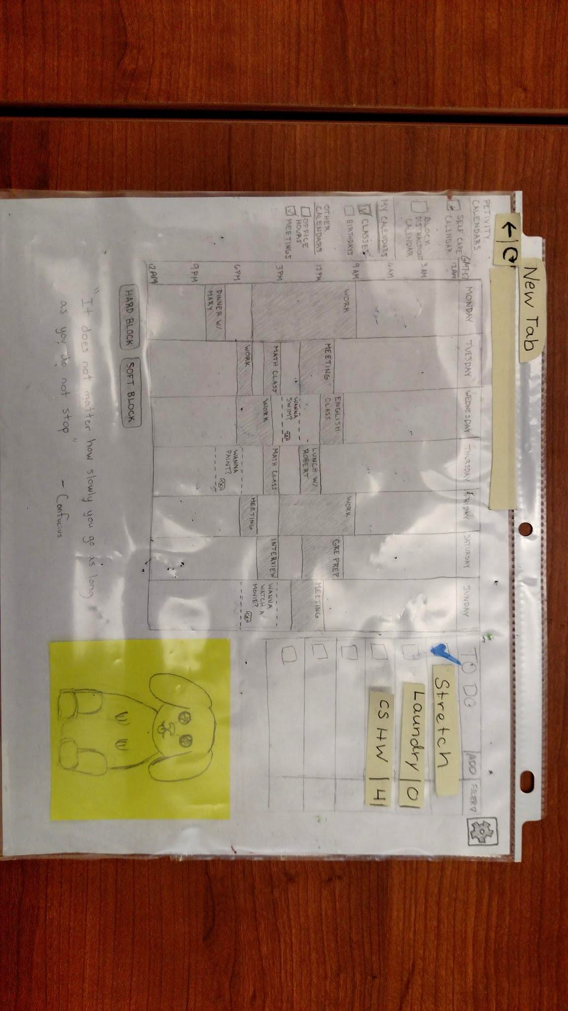
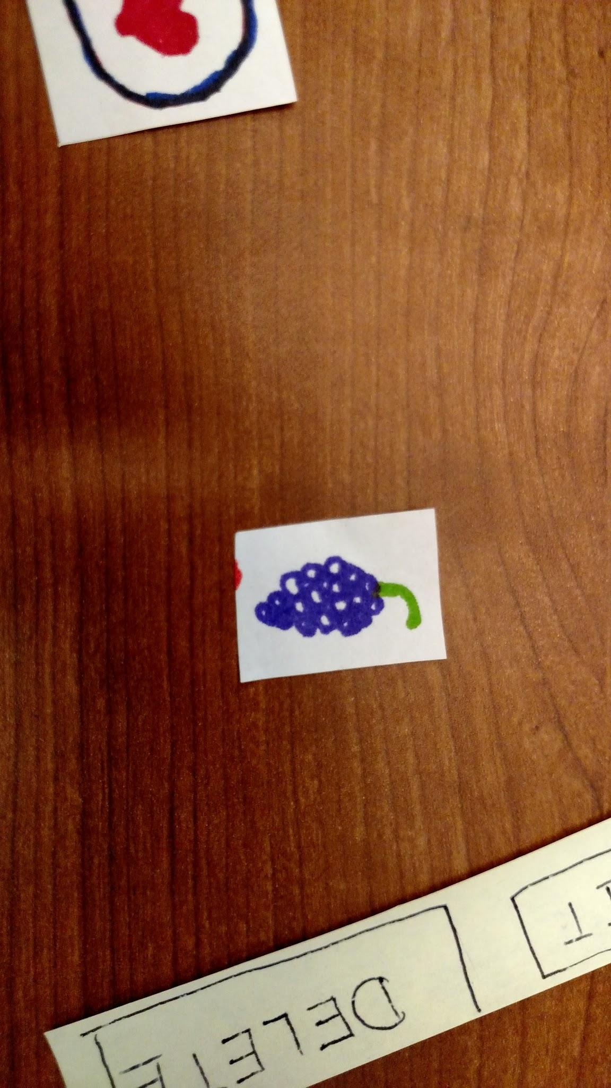
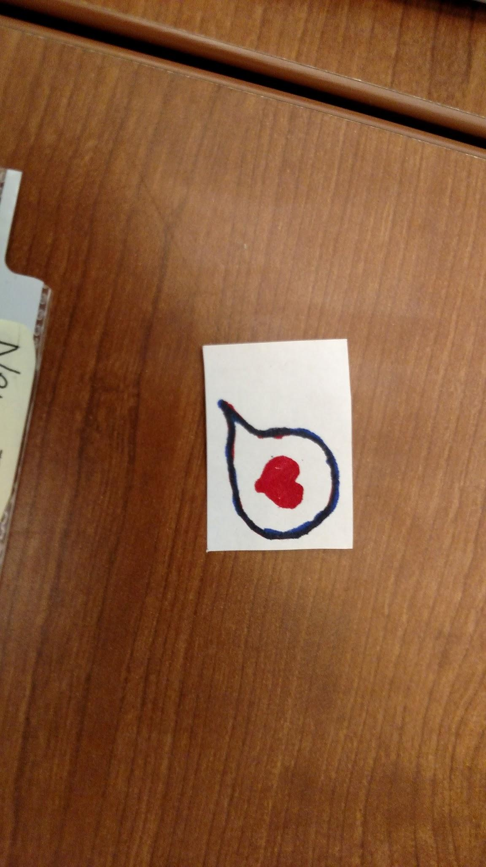
Task 1
Notes:
Productivtiy because most people can relate to it

Slide 14
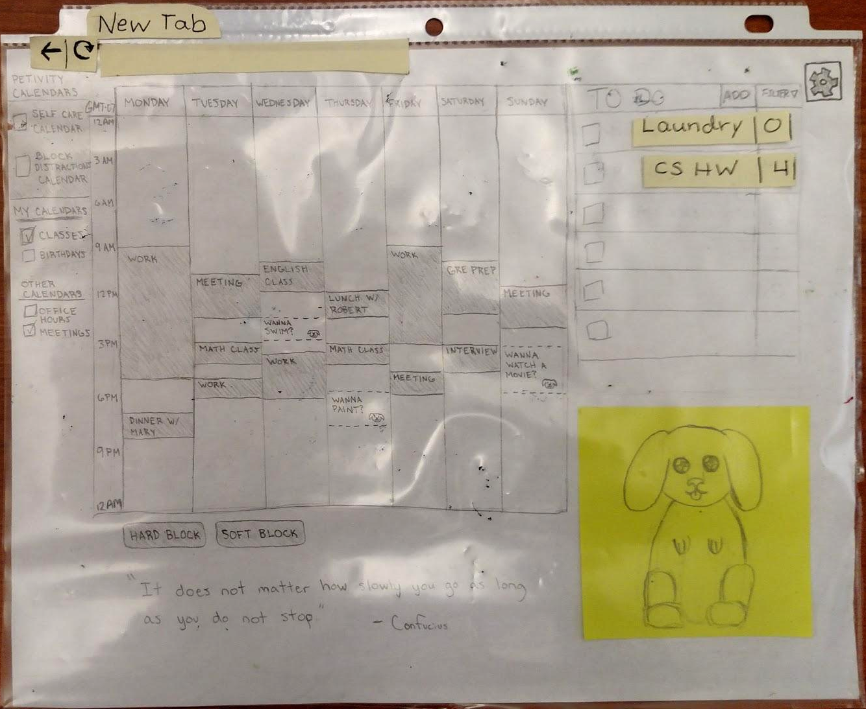
Task 1
Notes:
Productivtiy because most people can relate to it

Slide 15
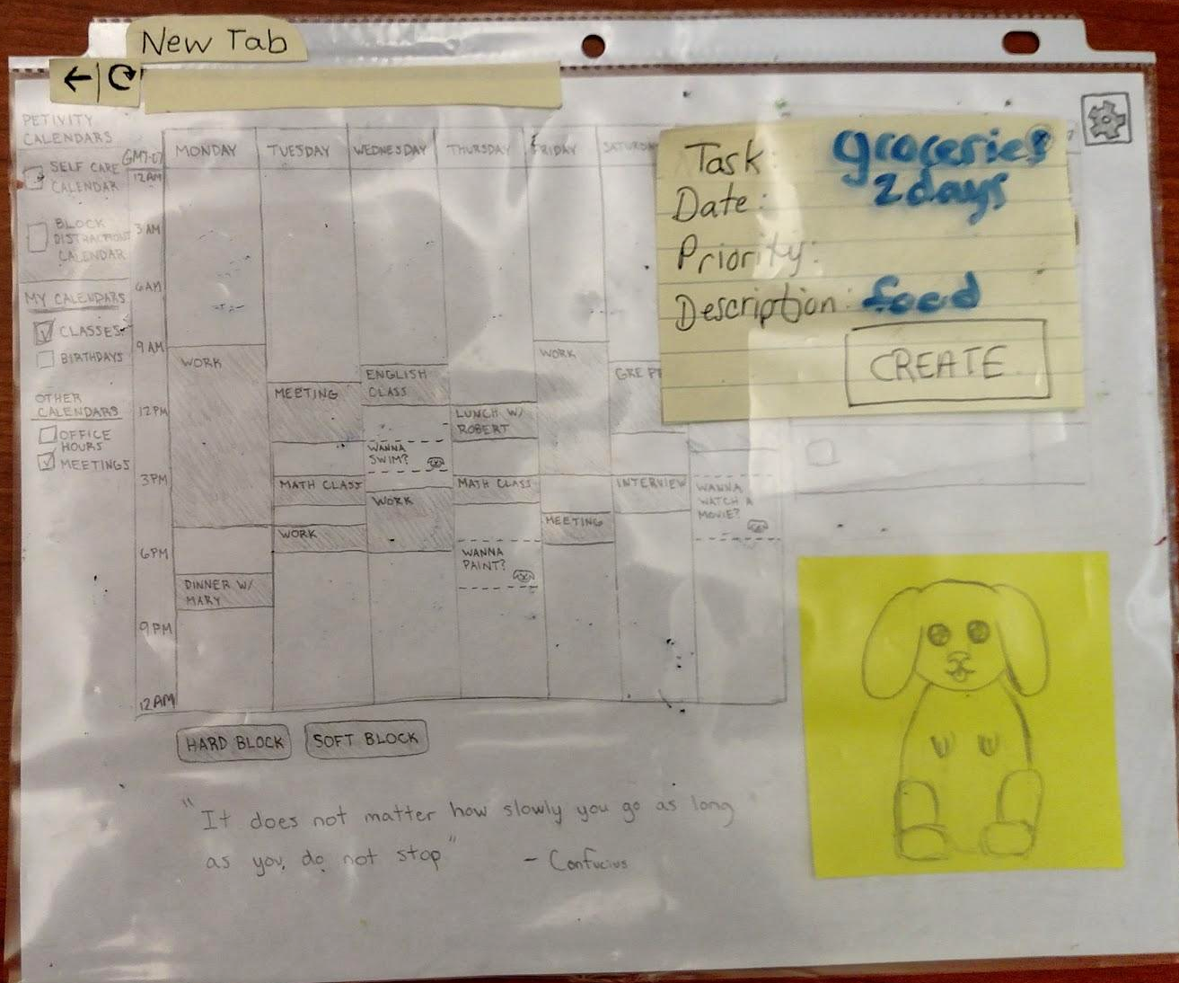
Task 1
Notes:
Productivtiy because most people can relate to it

Slide 16
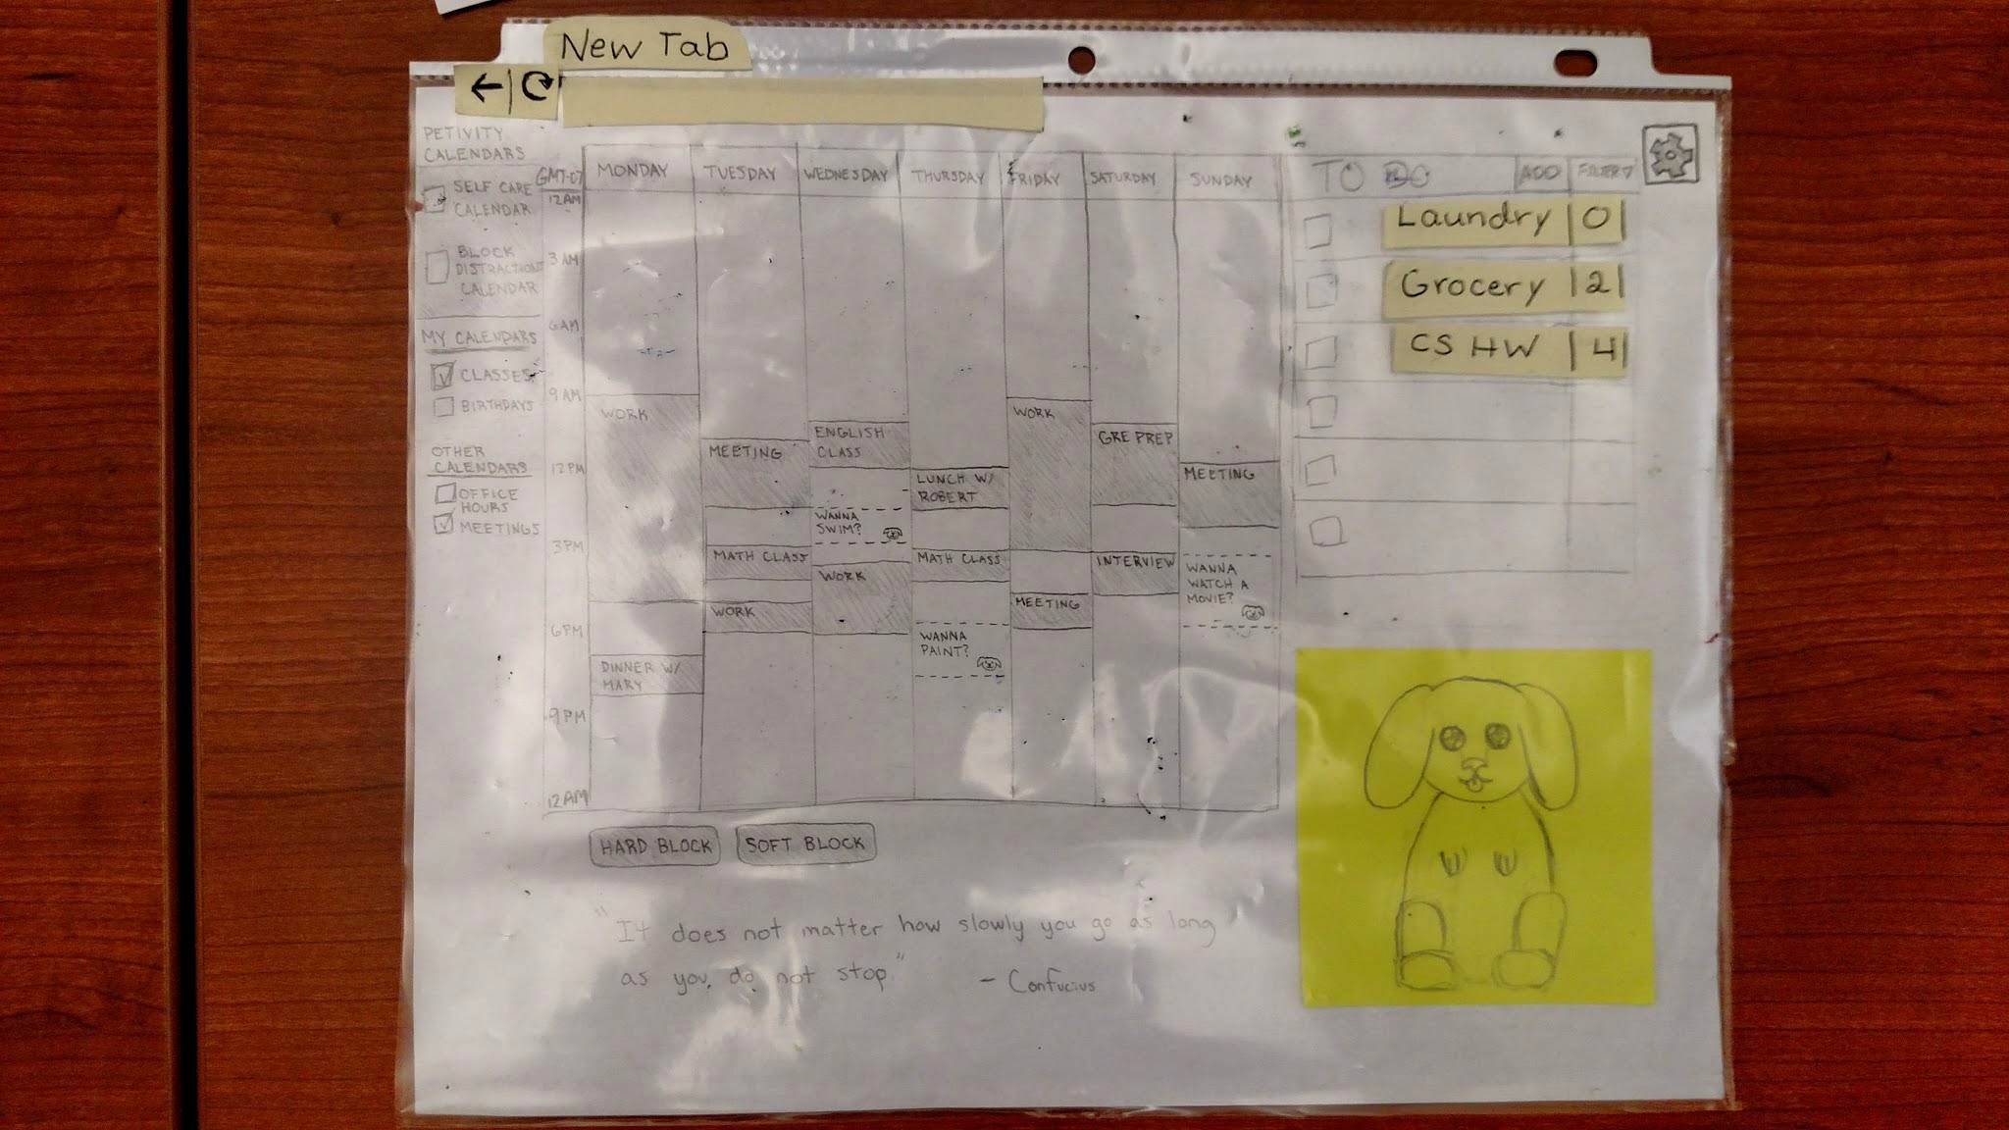
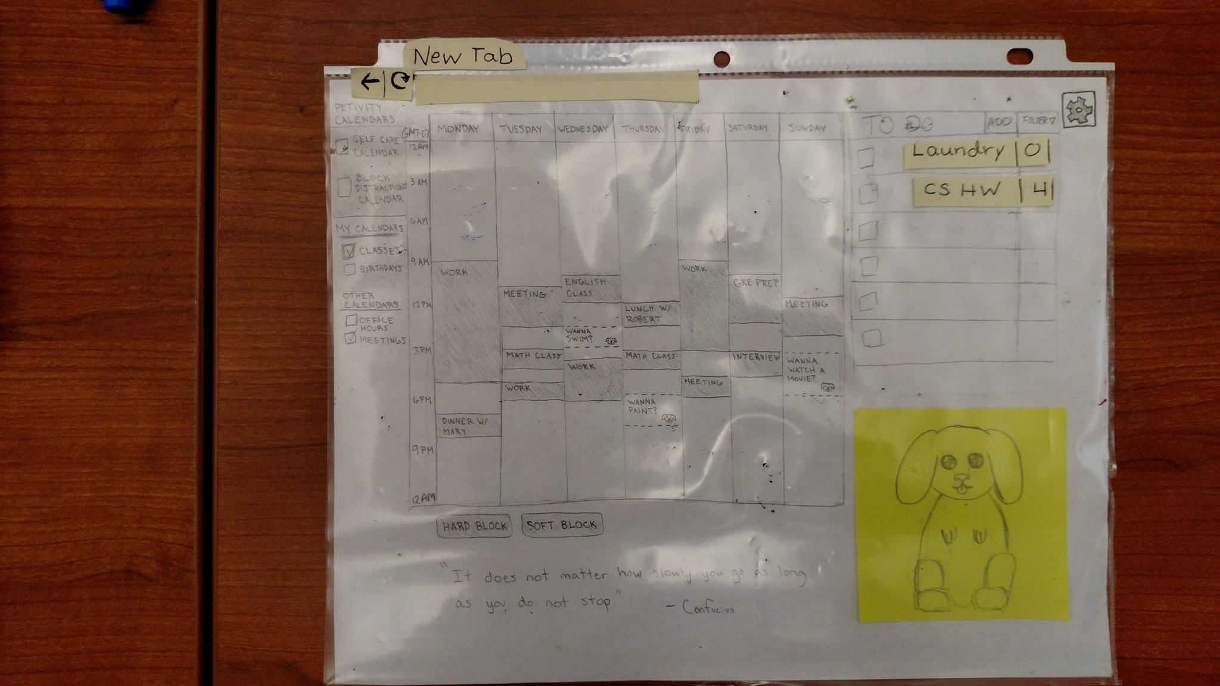
Task 1
Notes:
Productivtiy because most people can relate to it

Slide 17
Task 2
Notes:
Productivtiy because most people can relate to it

Slide 18
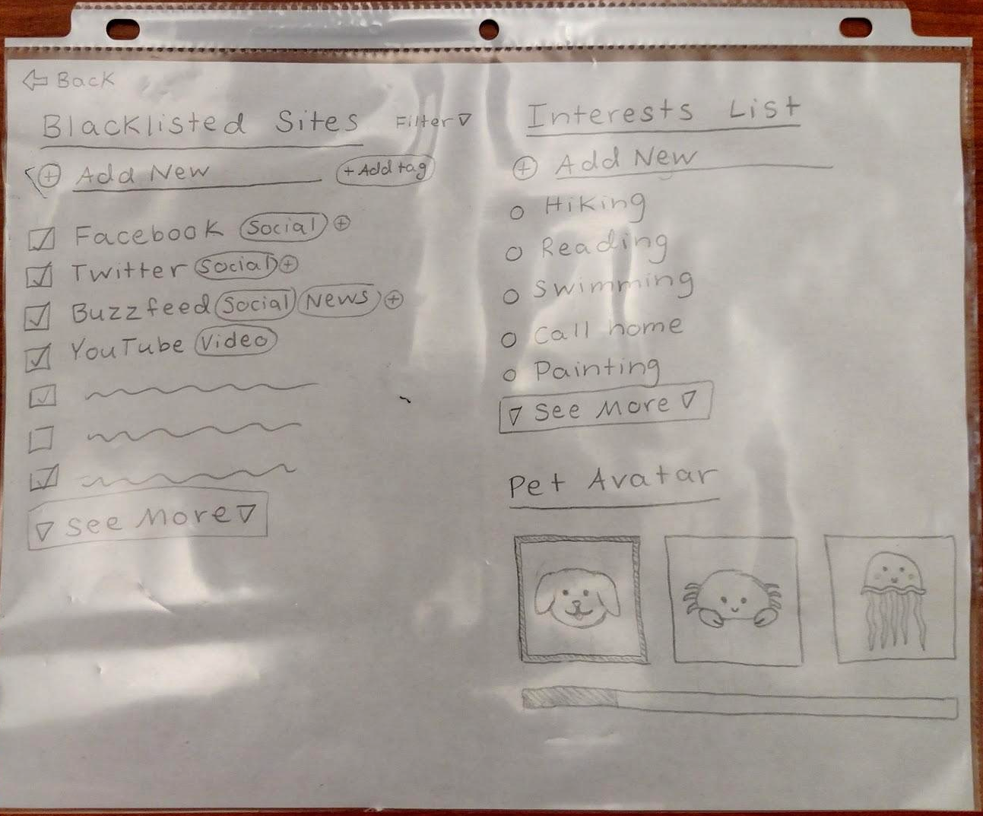
Task 2
Notes:
Productivtiy because most people can relate to it

Slide 19
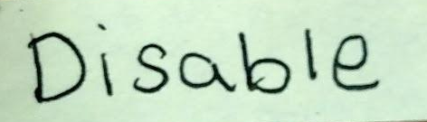
Task 2
Notes:
Productivtiy because most people can relate to it

Slide 20
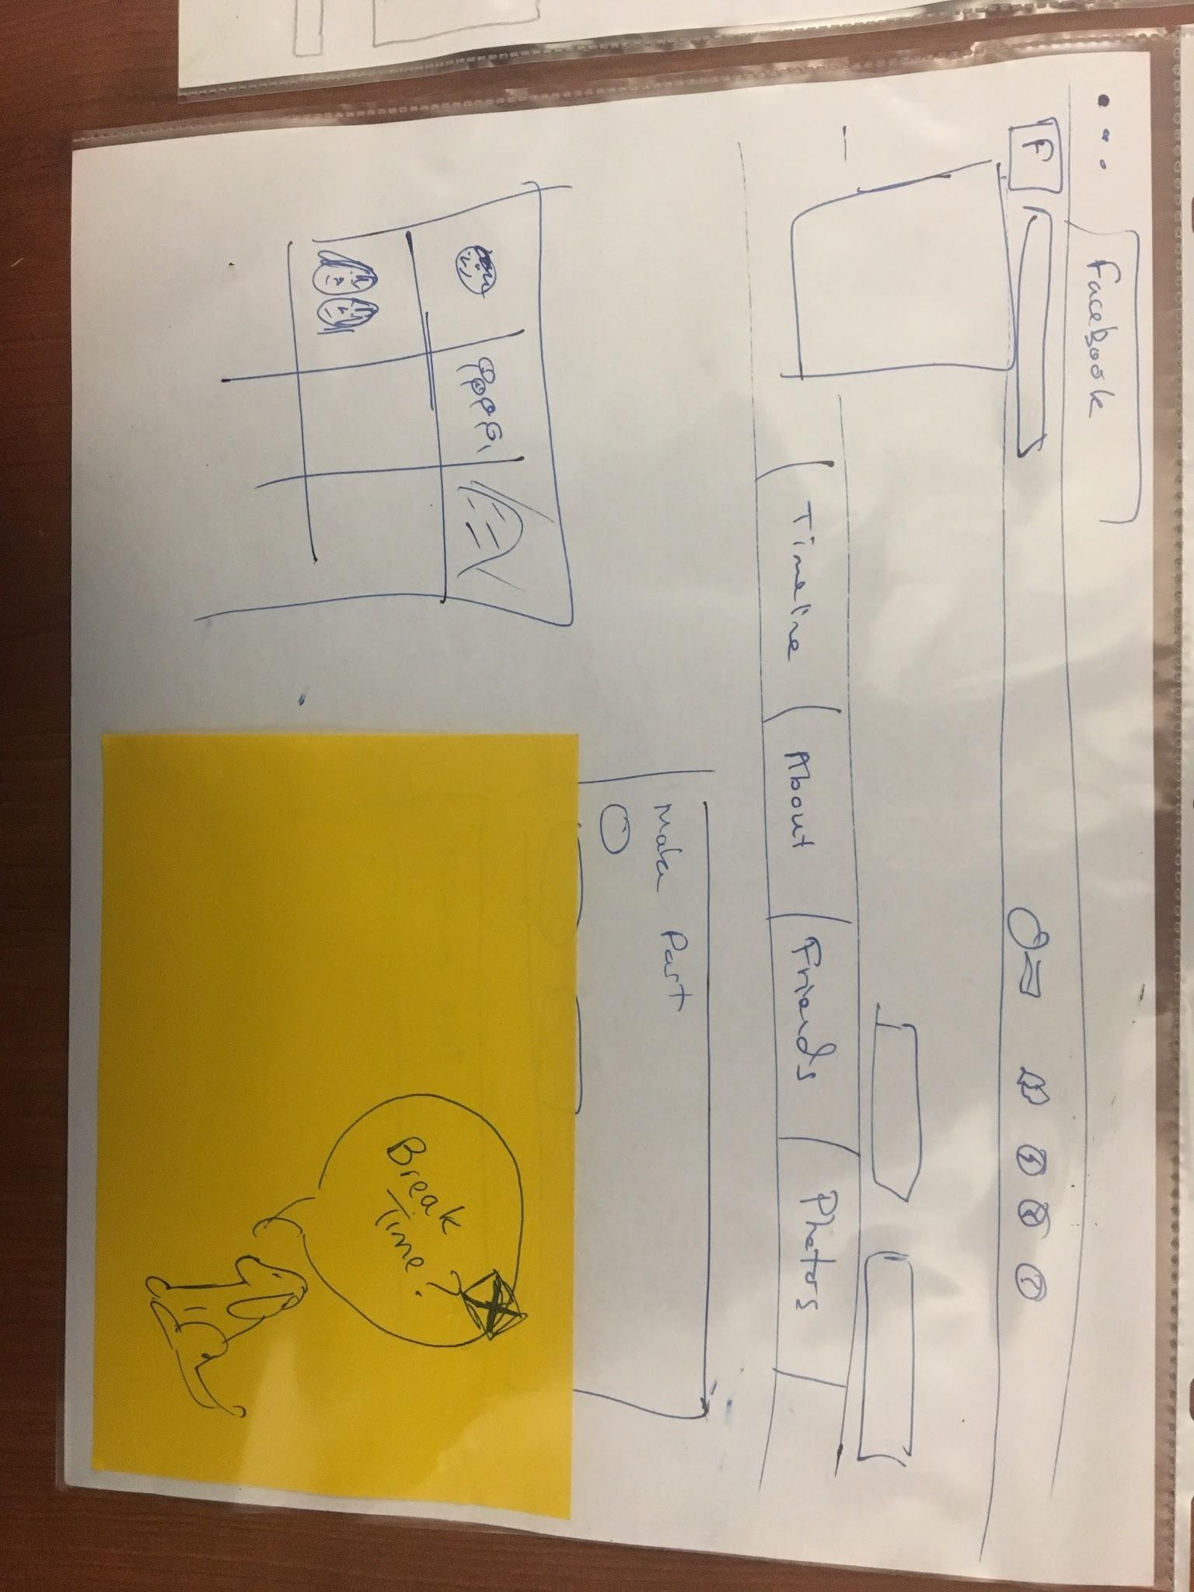
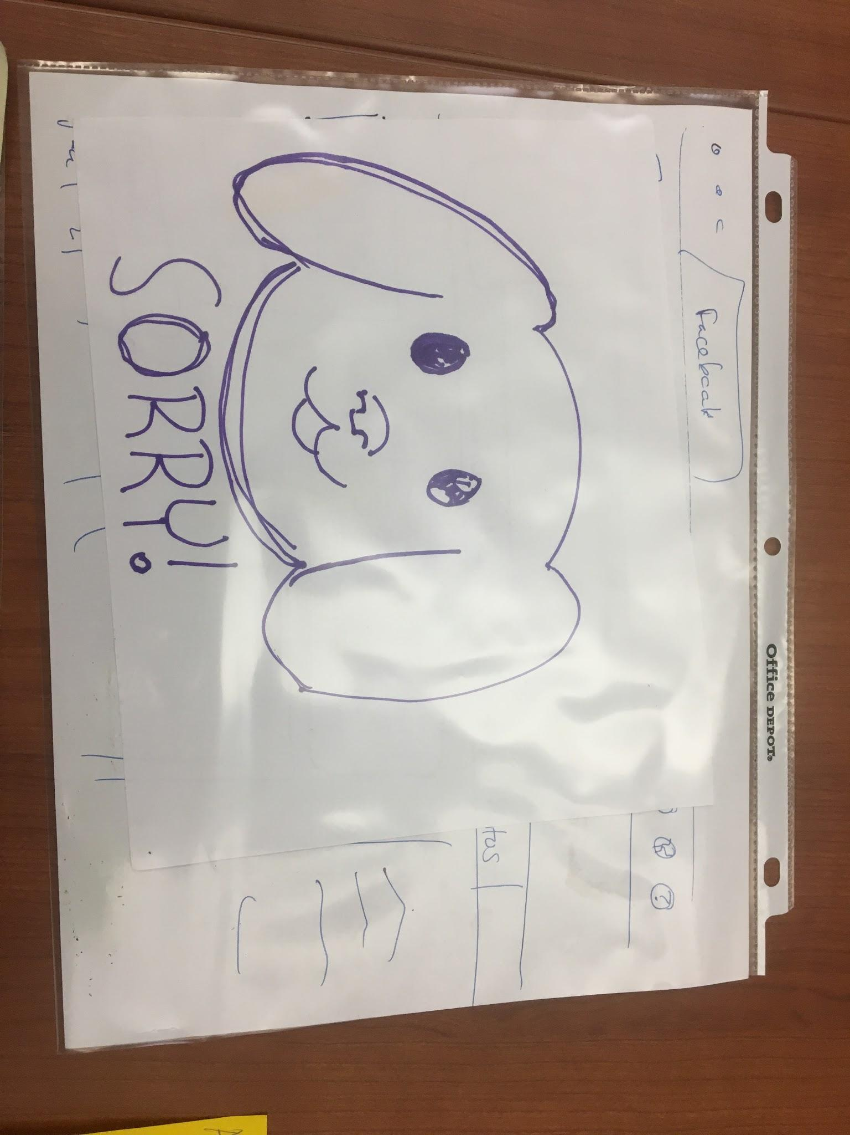
Task 2
Notes:
Productivtiy because most people can relate to it

Slide 21
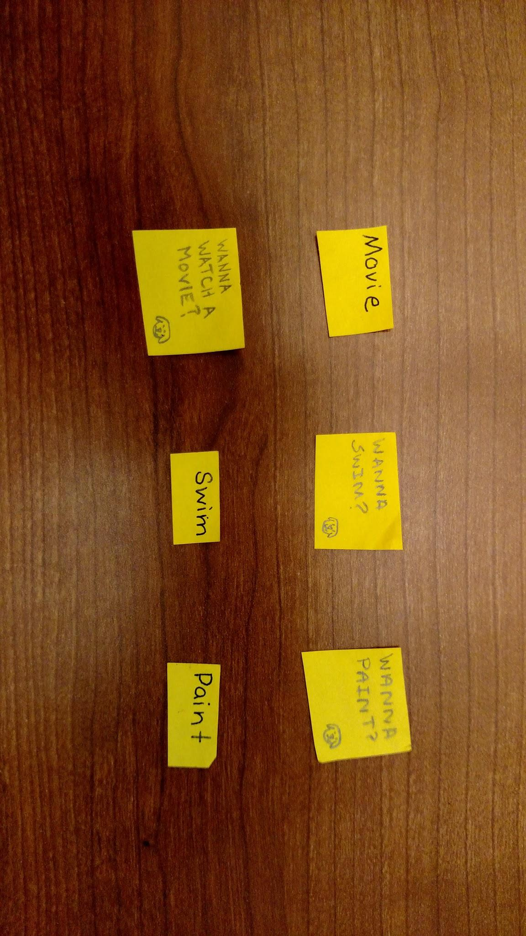
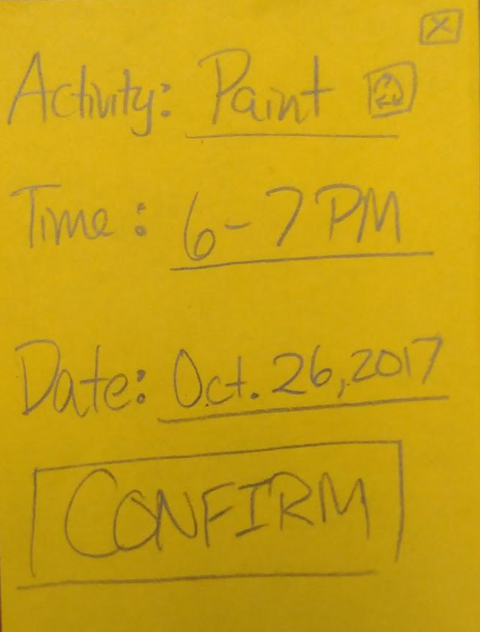
Task 3
Notes:
Productivtiy because most people can relate to it

Slide 22
Task 3
Notes:
Productivtiy because most people can relate to it

Slide 23
Experimental Method
Participant 1
Caucasian female
Late 20’s
Preschool teacher
Waiting for coffee at off-campus Starbucks
Participant 2
Hispanic male
Early 20’s
Student at Foothill college
Studying at off-campus Starbucks
Participant 3
African- American male
No older than 20
Sophomore at Stanford
Studying at on-campus undergrad. residence

Slide 24
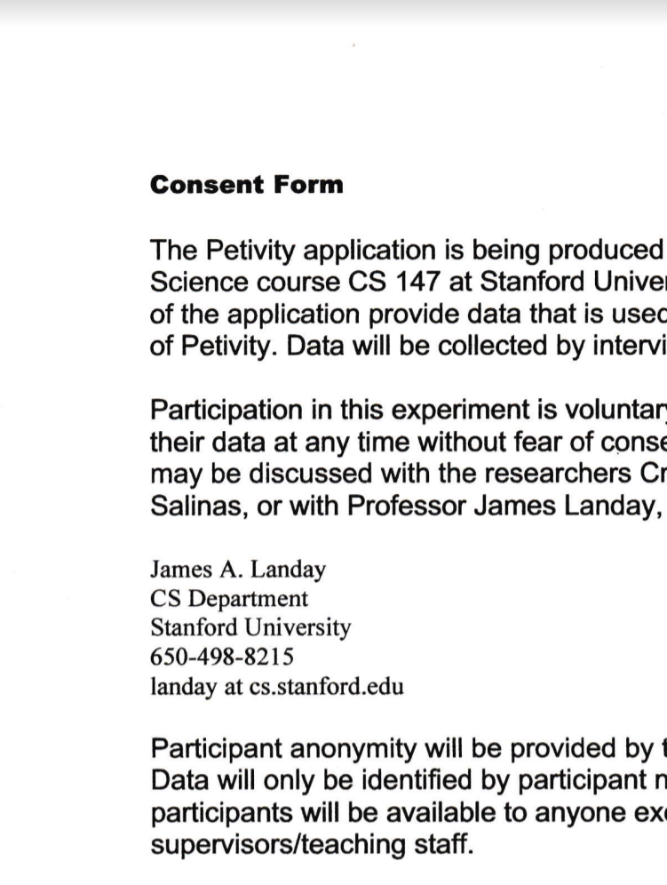
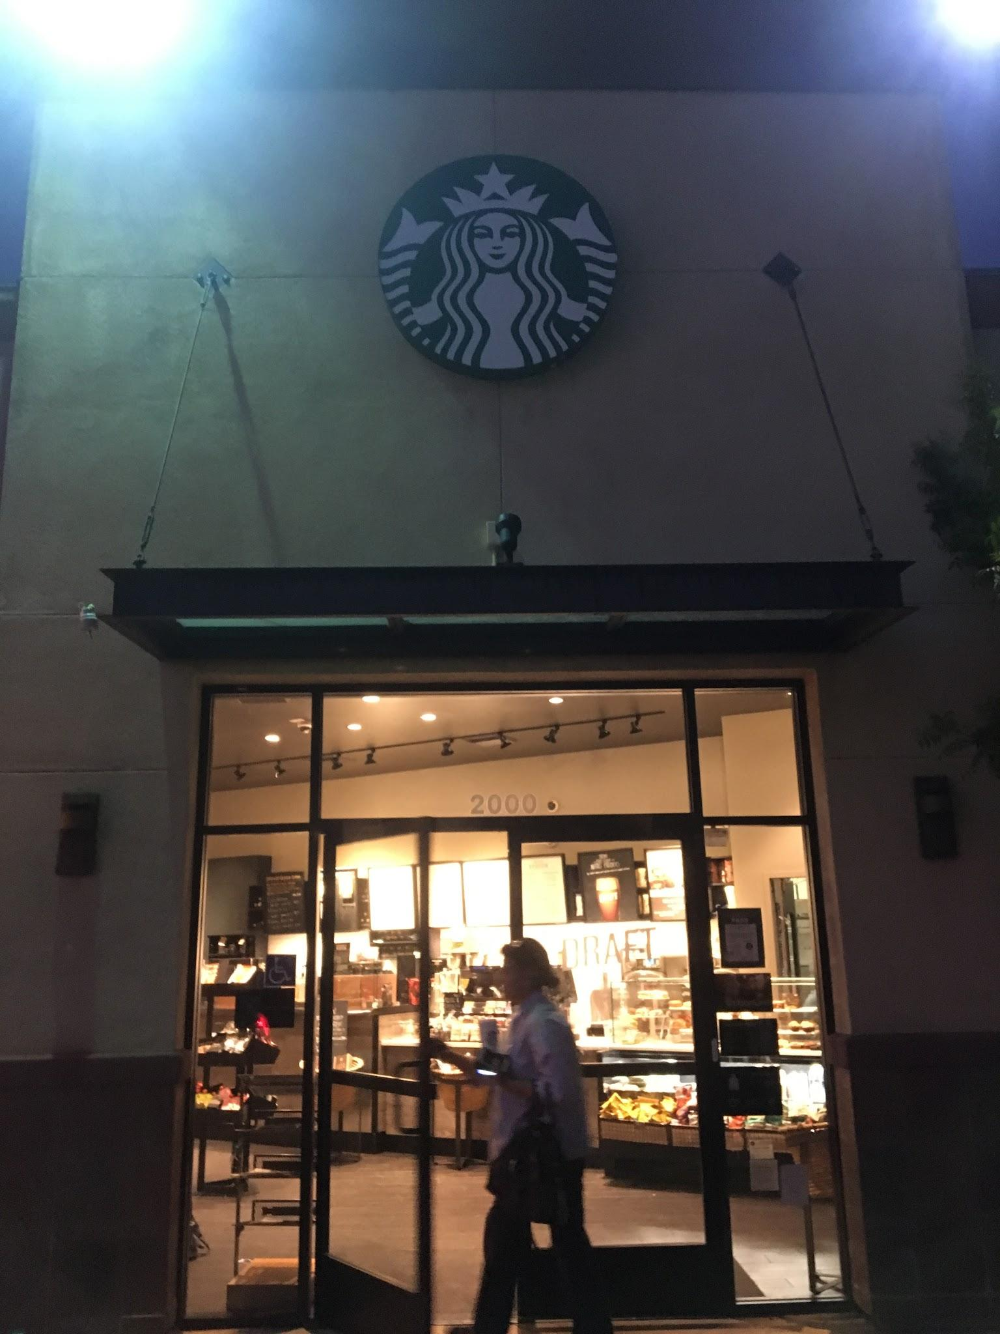
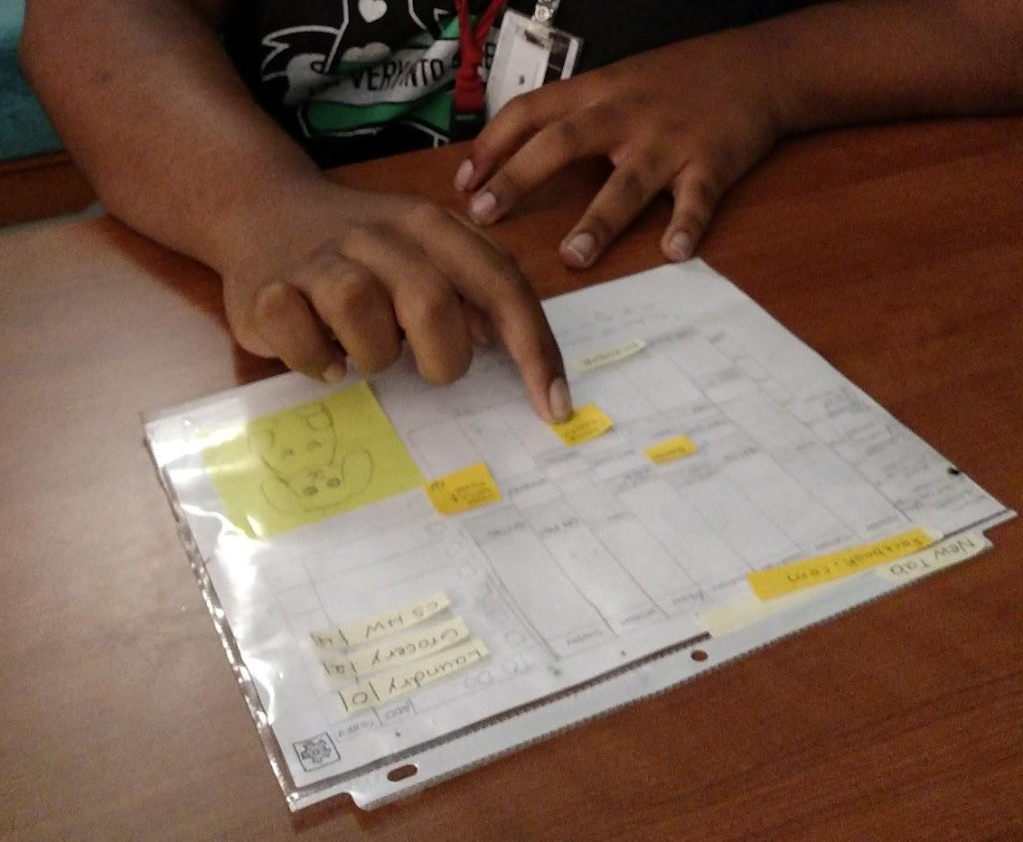
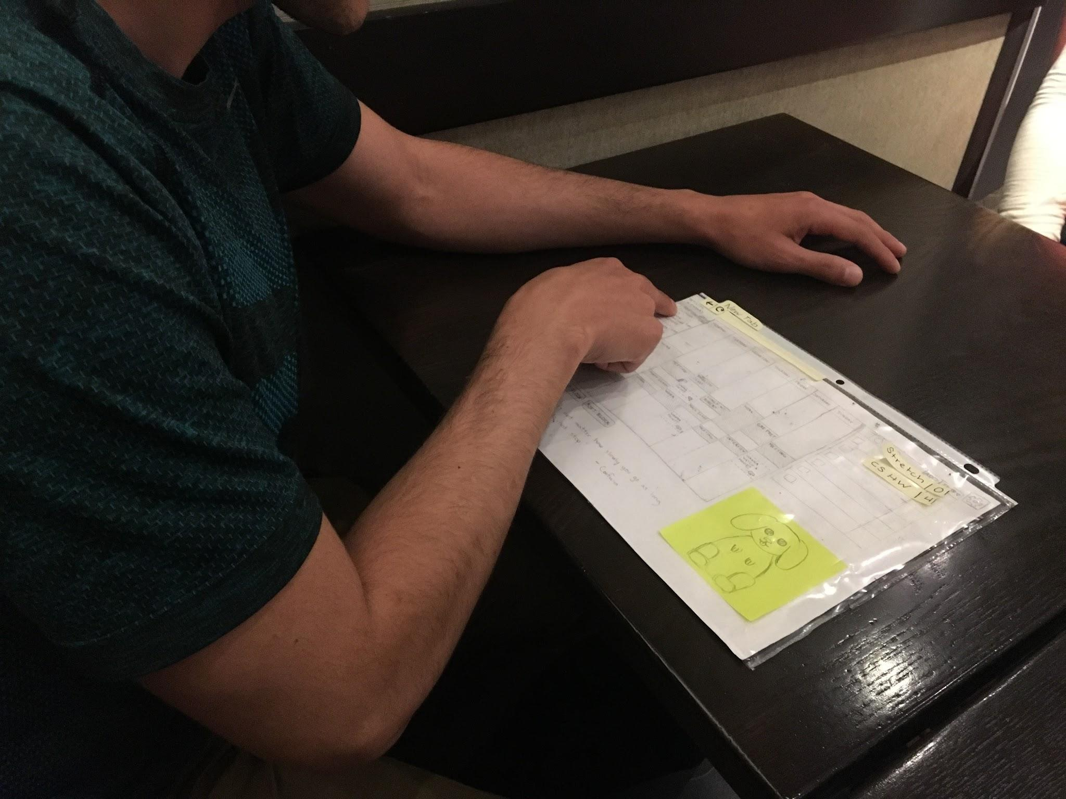
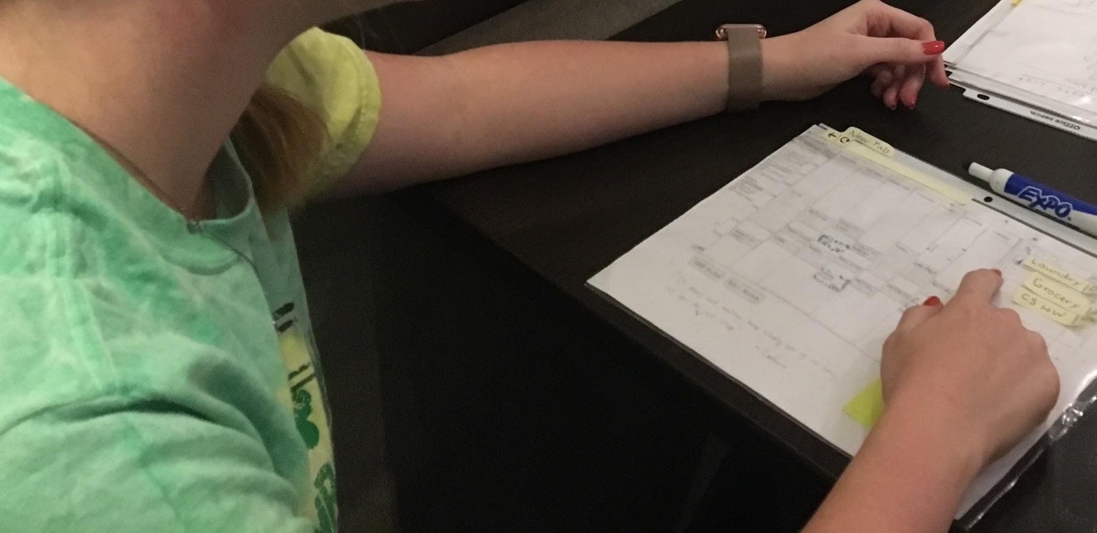
Results

Slide 25
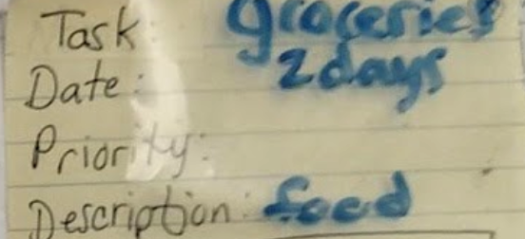
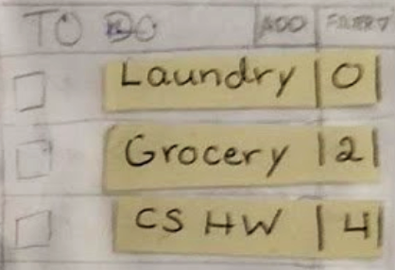
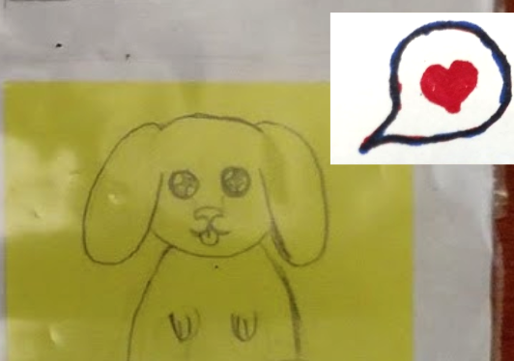
Task 1
Participants 2 and 3 were confused by the priority slot in the task dialog box
Participant 2 didn’t see the to-do list at first, and interpreted the calendar items as to-do’s
Participant 3 didn’t understand the purpose of the numbers in the right column of the to-do list
All the participants enjoyed the pet avatar and commented on how they liked how completing the task would feed the pet

Slide 26
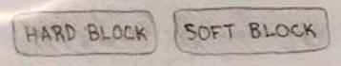
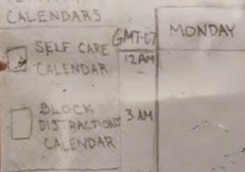
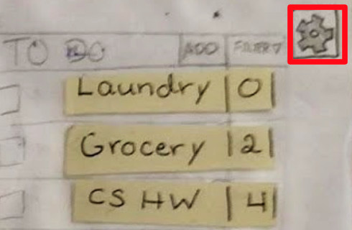
Task 2
All three participants were confused by the wording of “soft” and “hard block”
All three participants noticed the “block distractions” calendar on the left side of the interface and were confused by it
All three participants had difficulty navigating to the settings page to edit list of blocked sites when completing task 2
Participant 1 smiled when she saw the soft and hard block page when she navigated to Facebook

Slide 27
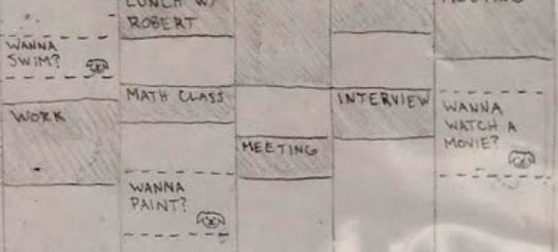
Task 3
Participants 2 and 3 had trouble locating the self-care suggestions on calendar
Participant 2 was troubled by the font size on the calendar
Participant 2 thought the distinction between between the self-care events and normal events on the calendar were not clear enough

Slide 28
Recommended Improvements
Notes:
We realized we needed more information so we did some additional needfinding

Slide 29
UI Improvements
Use color/shape to make calendar and to-do list more distinct from each other
Remove task priorities and organize tasks by number of days left until deadline
Make the settings button more noticeable or include an input field for quickly adding distracting websites on the main screen
Implement single block button and move soft/hard blocking option to settings
Use color, shape, and/or animation to further distinguish self-care items from scheduled items in calendar

Slide 30
Summary
Web application interface best quick, at-a-glance reminders of tasks and schedule
Tested on three users
Positive reinforcement well received
Interactions with blocking feature could be more intuitive
Use color/animation to distinguish self-care items from scheduled events in calendar
Notes:
We formulated our final strongest HMW

Slide 31

Thank You!
Any Questions?

